Slide 1

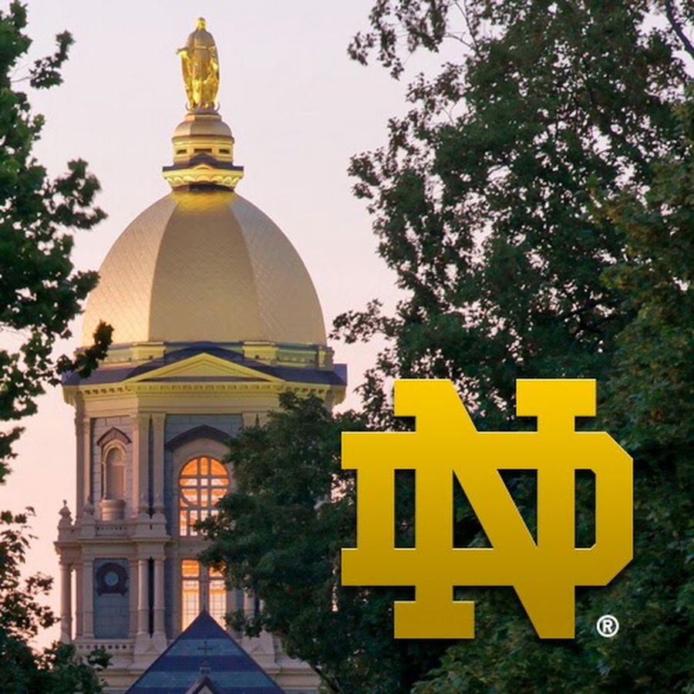
Pets Image Classification Solution (PICS)
Ashish Gupta
Masters in Applied Mathematics & Statistics, Class of 2021

Slide 2
AGENDA
Problem statement
Data Exploration
Approach
Models considered
Pre-Processing
Model evaluation
Challenges and lessons learned
Q & A

Slide 3
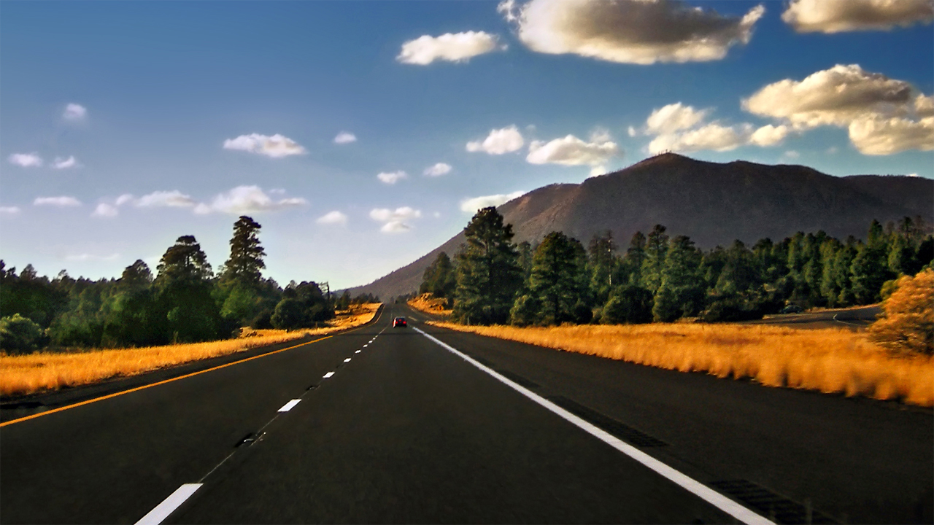



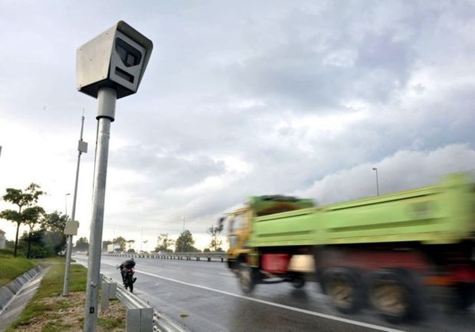
PROBLEM STATEMENT
Create a machine learning based image classification solution to identify and distinguish between dogs and horses for wandered farm animals on a certain stretch of proposed Interstate Highway 11.

Slide 4
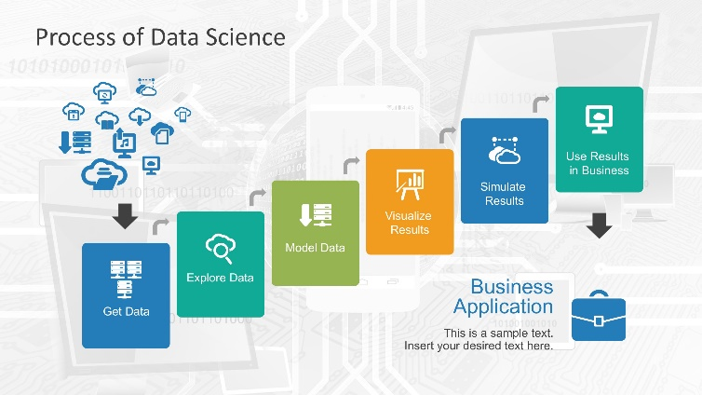
APPROACH

Slide 5
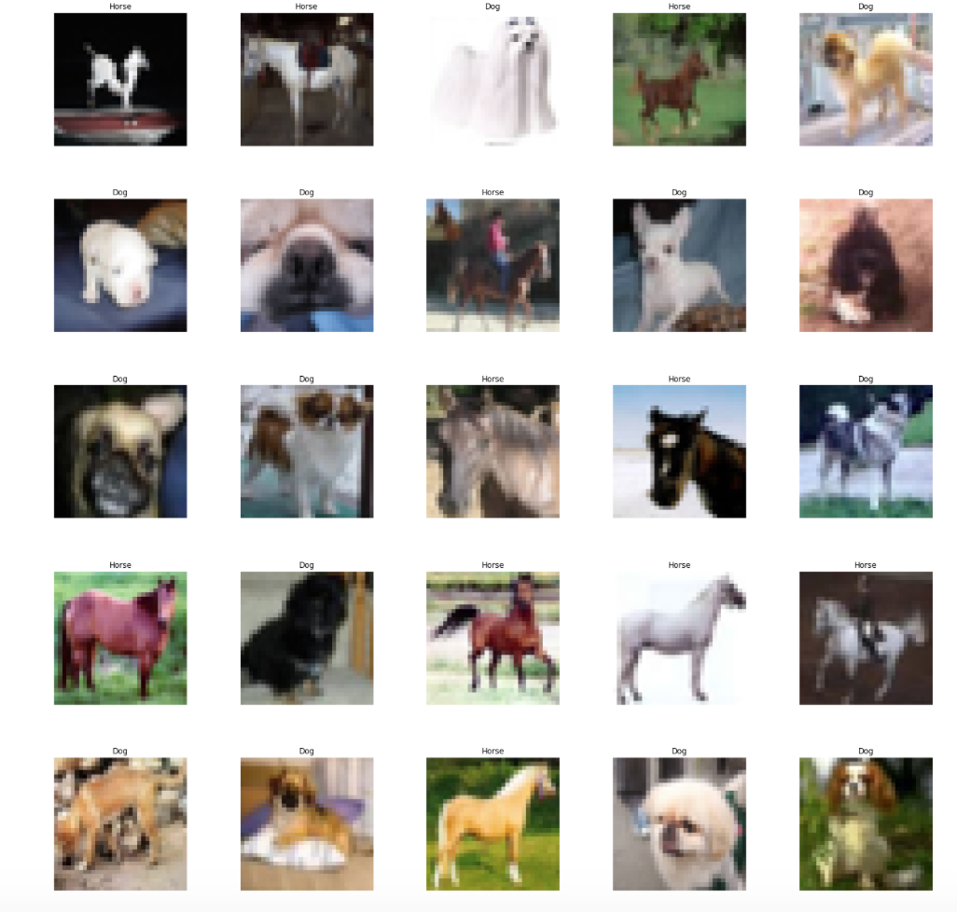
DATA EXPLORATION
CIFAR Dataset
60k Colored RGB Images
10 Animal types: airplanes, cars, birds, cats, deer, dogs, frogs, horses, ships, and trucks.
Equal distribution of images for animal types
Each of the images are 32x32 color pixels
Problem data sub-set
12k Colored RGB images
Dogs and horses images only
8k, 2k & 2k images in training, test & validation datasets

Slide 6
Models considered
Selection Criteria
Binary classification machine learning models for image classification
Metric – Accuracy
Selected Models
Model | Accuracy
Random Forest/dimension reduction | 0.745
Gradient Boosted Decision Trees/dimension reduction | 0.774
Fully Connected Neural Networks/dimension reduction | 0.788
Fully Connected Neural Networks | 0.724
Support Vector Machines | 0.910
Convolutional Neural Network | 0.914

Slide 7
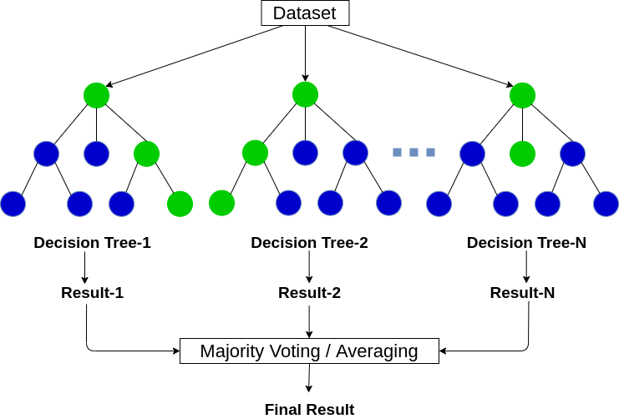
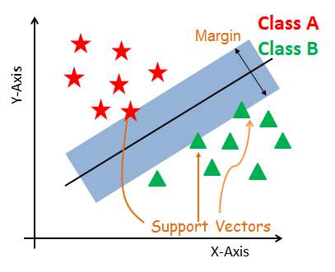
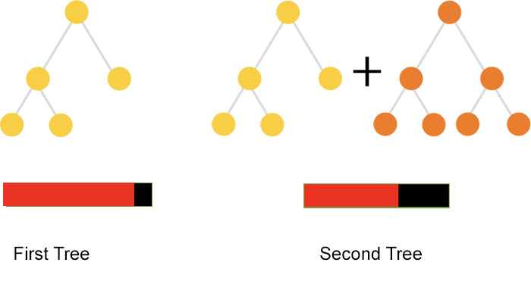
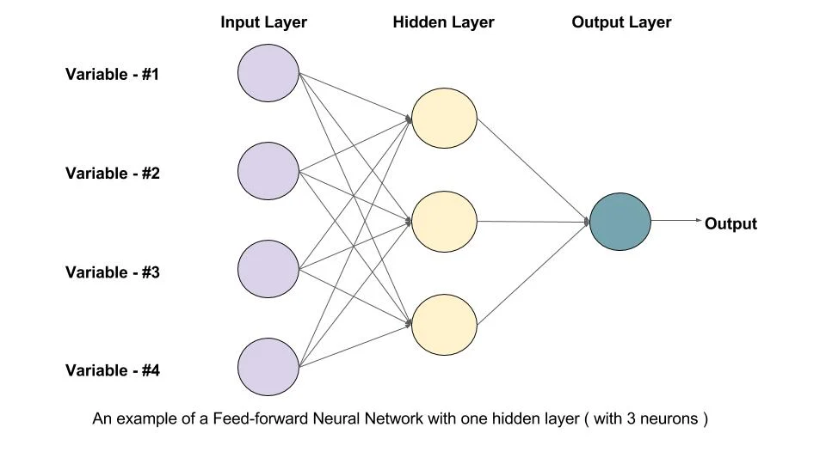

Models considered
Random Forest
Gradient Boosted Decision Trees
Support Vector Machines
Feed-Forward Neural Network
Convolutional Neural Network

Slide 8
Pre-processing
Response variable re-labeling
Dog = 0, Horse = 1
Dimensional Reduction
PCA (k = 208), 95% variance
Image flattening
One-hot encoding
Response variable only
Neural Networks – FFNN, CNN
Model | Response variable re-labelling | Dimension Reduction | Image Flattening | One-hot coding
Random Forest/dimension reduction | Y | Y | Y | N
Gradient Boosted Decision Trees/dimension reduction | Y | Y | Y | N
Feed-forward Neural Networks/dimension reduction | Y | Y | Y | Y
Feed-forward Neural Networks | Y | N | Y | Y
Support Vector Machines | Y | N | Y | N
Convolutional Neural Network | Y | N | Y | Y

Slide 9
MODEL EVALUATION
Model | Accuracy
Random Forest/dimension reduction | 0.745
Gradient Boosted Decision Trees/dimension reduction | 0.774
Feed-forward Neural Networks | 0.724
Feed-forward Neural Networks/dimension reduction | 0.788
Support Vector Machines | 0.910
Convolutional Neural Network | 0.914
Notes:
A CNN is a deep learning algorithm which is mostly used for image classification
It can take an input image, assign importance (learnable weights and biases) to various aspects in the image, and be able to differentiate them.
The preprocessing required in a ConvNet (CNN) is much lower as compared to other classification algorithms. While in primitive methods filters are hand-engineered, but with enough training, ConNet have the ability to learn these filters or characteristics of an image.
you would think a normal machine learning classifier also can do the same thing, so why we need this CNN, well it’s all about speed and computation and accuracy.
1. CNN has many major advantages over an ML classifier, but you want to know the real deal, the reason of using CNN is it’s overhead on the processor is less than ML classifier and accuracy is higher. and as the world is shifting toward cloud infrastructure, it’s best suited to have a low processing model on the cloud machine.
2. And if you think We can use a simple Neural network then. well hear me this out, in a simple Neural Network, a 3x3 (pixels resolution) image matrix is turned into a 9x1 matrix so-called a vector so than we can feed it in a neural network of 9 starting node. and usually, 3x3 images are not used, bigger images are used and with more dimensions of the image matrix also, that’ll lead to a very big and wide Neural Network.
3. A ConvNet performs a better fitting to the dataset due to the reduction in the number of parameters involved. and NO by using reduction CNN doesn’t lose the features of the image.

Slide 10
BEST PERFORMING MODEL
Convolutional Neural Network -91.4%
Notes:
A CNN is a deep learning algorithm which is mostly used for image classification
It can take an input image, assign importance (learnable weights and biases) to various aspects in the image, and be able to differentiate them.
The preprocessing required in a ConvNet (CNN) is much lower as compared to other classification algorithms. While in primitive methods filters are hand-engineered, but with enough training, ConNet have the ability to learn these filters or characteristics of an image.
you would think a normal machine learning classifier also can do the same thing, so why we need this CNN, well it’s all about speed and computation and accuracy.
1. CNN has many major advantages over an ML classifier, but you want to know the real deal, the reason of using CNN is it’s overhead on the processor is less than ML classifier and accuracy is higher. and as the world is shifting toward cloud infrastructure, it’s best suited to have a low processing model on the cloud machine.
2. And if you think We can use a simple Neural network then. well hear me this out, in a simple Neural Network, a 3x3 (pixels resolution) image matrix is turned into a 9x1 matrix so-called a vector so than we can feed it in a neural network of 9 starting node. and usually, 3x3 images are not used, bigger images are used and with more dimensions of the image matrix also, that’ll lead to a very big and wide Neural Network.
3. A ConvNet performs a better fitting to the dataset due to the reduction in the number of parameters involved. and NO by using reduction CNN doesn’t lose the features of the image.

Slide 11
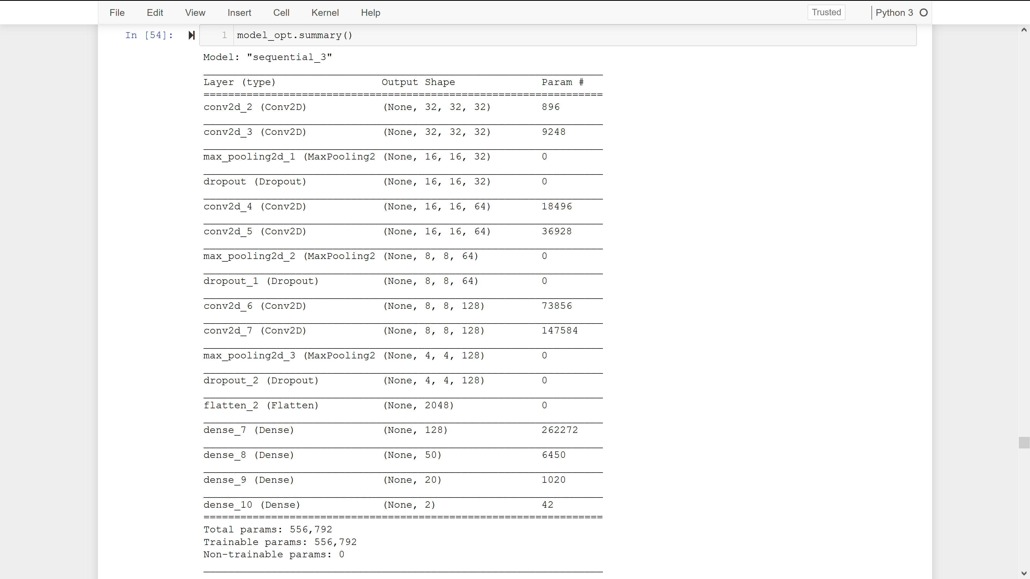
BEST PERFORMING MODEL – cnn structure
Notes:
A CNN is a deep learning algorithm which is mostly used for image classification
It can take an input image, assign importance (learnable weights and biases) to various aspects in the image, and be able to differentiate them.
The preprocessing required in a ConvNet (CNN) is much lower as compared to other classification algorithms. While in primitive methods filters are hand-engineered, but with enough training, ConNet have the ability to learn these filters or characteristics of an image.
you would think a normal machine learning classifier also can do the same thing, so why we need this CNN, well it’s all about speed and computation and accuracy.
1. CNN has many major advantages over an ML classifier, but you want to know the real deal, the reason of using CNN is it’s overhead on the processor is less than ML classifier and accuracy is higher. and as the world is shifting toward cloud infrastructure, it’s best suited to have a low processing model on the cloud machine.
2. And if you think We can use a simple Neural network then. well hear me this out, in a simple Neural Network, a 3x3 (pixels resolution) image matrix is turned into a 9x1 matrix so-called a vector so than we can feed it in a neural network of 9 starting node. and usually, 3x3 images are not used, bigger images are used and with more dimensions of the image matrix also, that’ll lead to a very big and wide Neural Network.
3. A ConvNet performs a better fitting to the dataset due to the reduction in the number of parameters involved. and NO by using reduction CNN doesn’t lose the features of the image.

Slide 12
Q & A
Thank You

